Slide 1

Crush Injury
Best practices and protocols
San Bernardino County
EMS Educators

Slide 2

Goals
Pathophysiology
Assessment
Treatment
Medications

Slide 3

Objectives
The EMS provider will understand the pathophysiology of a crush injury.
Provider will be able to assess a crush injury.
The EMS provider will understand the medications to be used with the crush injury patient and inclusion criteria.

Slide 4
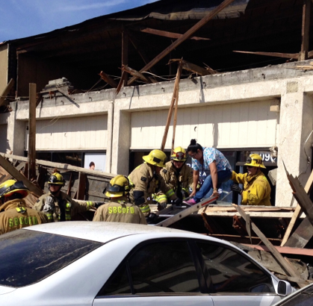
The Pathophysiology
Crush injury is the result of Ischemia then Reperfusion

Slide 5
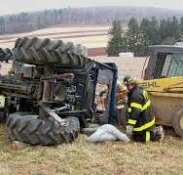
Pathophysiology Cont.
The injury to the soft tissues, muscles, and nerves can be due to the primary direct effect of the trauma or ischemia related to compression. In addition to direct muscle injury, after the release of the compressive force, severe crush injury results in swelling in the affected areas, with possible muscle necrosis and neurologic dysfunction.

Slide 6
The Sequela
Crush Injury: Result of physical trauma from prolonged compression of the torso, limb(s) or other parts of the body.
Crush Syndrome: The systemic manifestations resulting from crush injury, which can result in organ dysfunction; predominantly AKI, but multisystem injury can occur.
Initial Injury
External pressure compresses muscles
Ischemia and Reperfusion
Once released there’s a surge of blood flow, carrying toxins and waste to the bloodstream.
Release of toxins/metabolic waste
Substances flood the bloodstream potentially overwhelming the kidneys

Slide 7
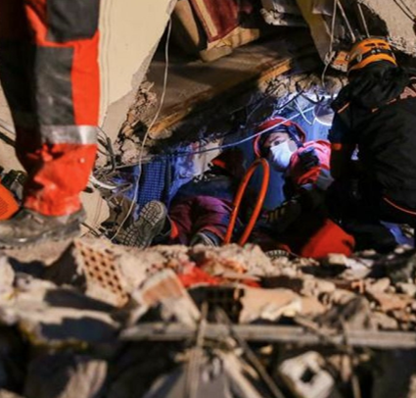
Assessment
Scene Safety
Primary Assessment
IV Access
Early ACTIVATION of the HERT TEAM through COMM. Center enables resource preparation, with the option to cancel at any time.

Slide 8
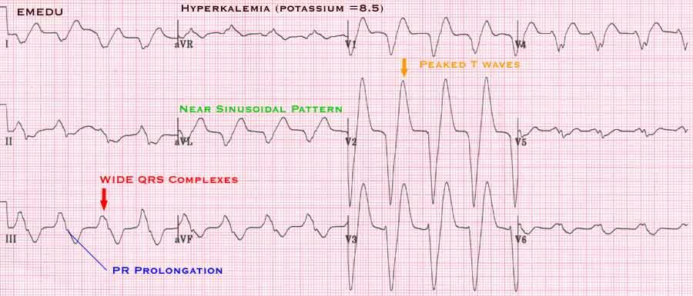
Potassium Release
The release of potassium from injured and necrotic muscles and other tissues can lead to a rapid onset of hyperkalemia and ventricular fibrillation.
The larger the mass crushed, the greater the likelihood of severe rhabdomyolysis and renal failure, increasing the risk of hyperkalemia.

Slide 9
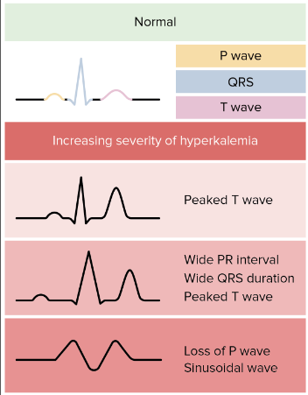
Hyperkalemia Progression
Notes:
Hyperkalemia

Slide 10
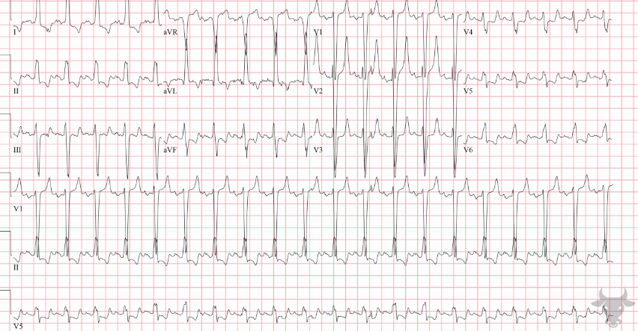
EKG w/ Peaked T waves

Slide 11

Trauma Protocol #14090
Crush Injuries with suspected hyperkalemia (entrapment greater than 4 hours and/or abnormal EKG findings- peaked “T” waves, absent “P” waves and widened QRS:
  Establish IV/IO, administer 500 ml bolus, May repeat one (1) time to a maximum of 1000 ml.
  Albuterol per ICEMA Reference #11010-Medication-Standard Orders
  Calcium Chloride per ICEMA Reference #11010-Medication-Standard Orders
  Sodium Bicarbonate per ICEMA Reference #11010-Medication-Standard Orders

Slide 12
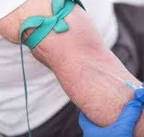
Normal Saline
Dose: 500mls, may repeat 1 time to a maximum of 1000ml.
Route: IV
Reason: Large volume resuscitation can prevent secondary renal failure and death.
Pearls: IV hydration should begin prior to extrication whenever possible.

Slide 13
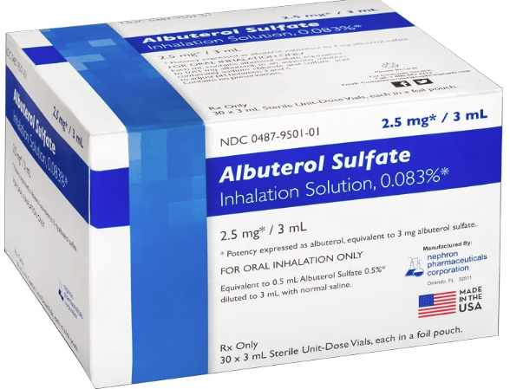
Albuterol
Dose: 2.5mg, MR twice OR 7.5mg continuous
Route: Nebulized
Reason: Decreases extracellular K+ by shifting it from extracellular space into the intracellular space.

Slide 14
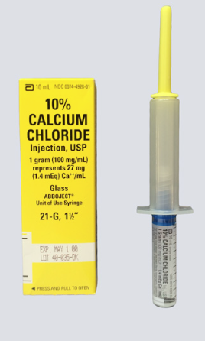
Calcium Chloride
Dose: 1gm (10ml of a 10% solution)
Route: IV/IO (Never IM)
Reason: Reduces the cardiac arrhythmia effect of potassium.
Pearls:
  Push slowly to avoid cardiac arrest.
  Ensure patency of IV/IO, extravasation can occur
  Do not administer solutions that are not clear/ have precipitate

Slide 15
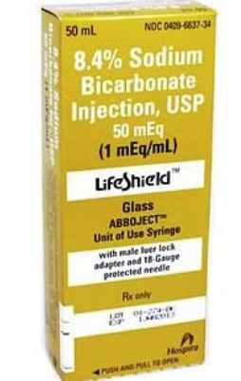
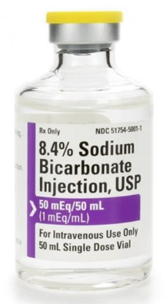
Sodium Bicarbonate
Dose: 50 mEq (50ml preload or 50ml single-dose vial
Route: IV/IO
Reason: Acts as an alkalinizing agent by releasing bicarbonate ions.
Pearls: May be given rapidly, flush IV line after administration to prevent incompatible medication from precipitating.

Slide 16
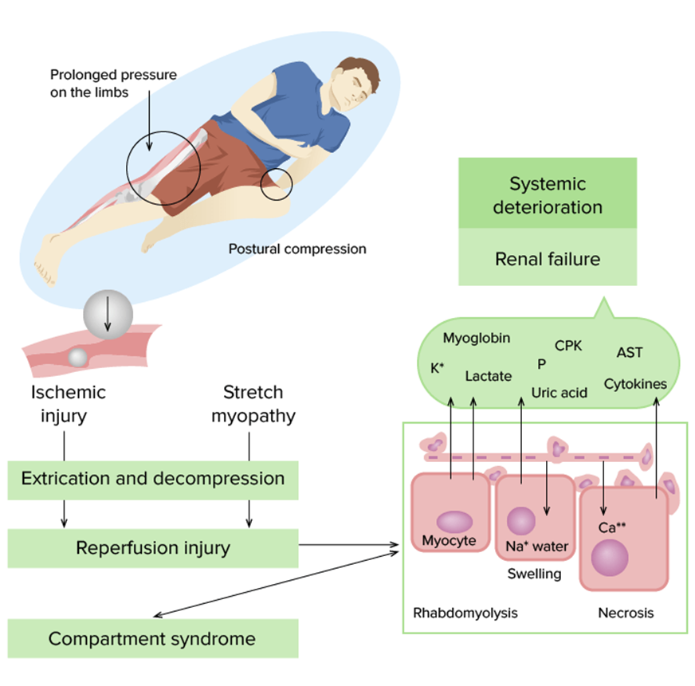
Policy # 11010 Medication-Standard Orders –Crush Injuries Treatment
Crush Injuries with Suspected Hyperkalemia (Prolonged entrapment and/or abnormal EKG findings):
Establish IV NS, administer 500 ml bolus. May repeat one (1) time to a maximum of 1000 ml.
Transport to appropriate hospital.

Slide 17
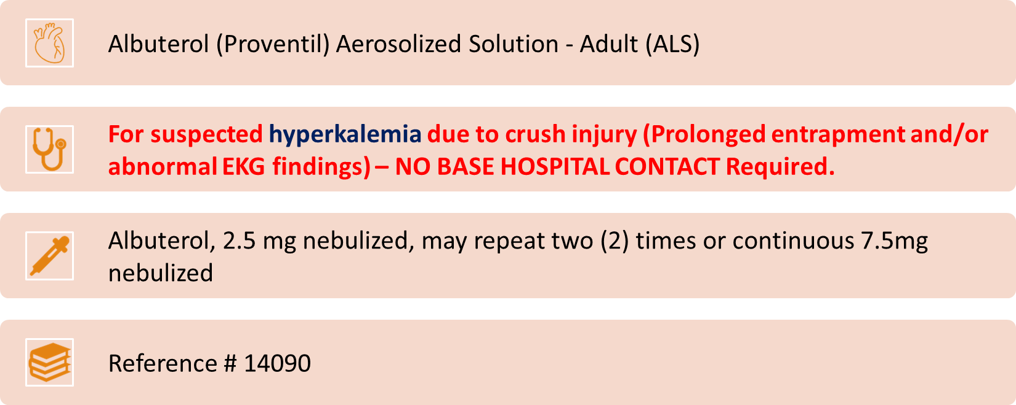
Policy # 11010 Medication-Standard Orders –Crush Injuries Treatment

Slide 18
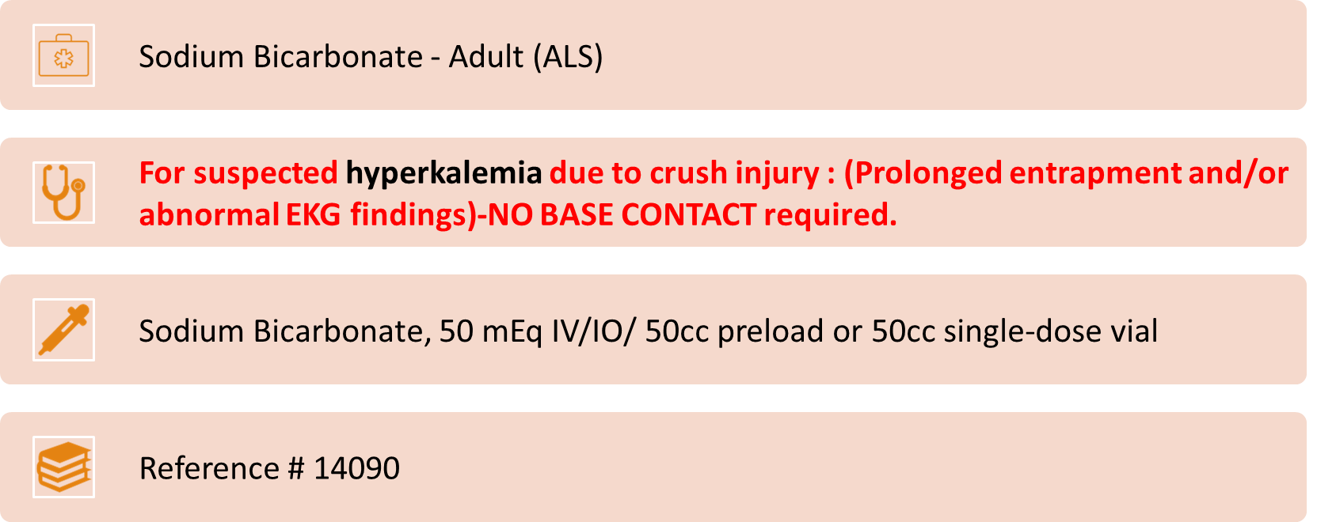
Policy # 11010 Medication-Standard Orders –Crush Injuries Treatment

Slide 19
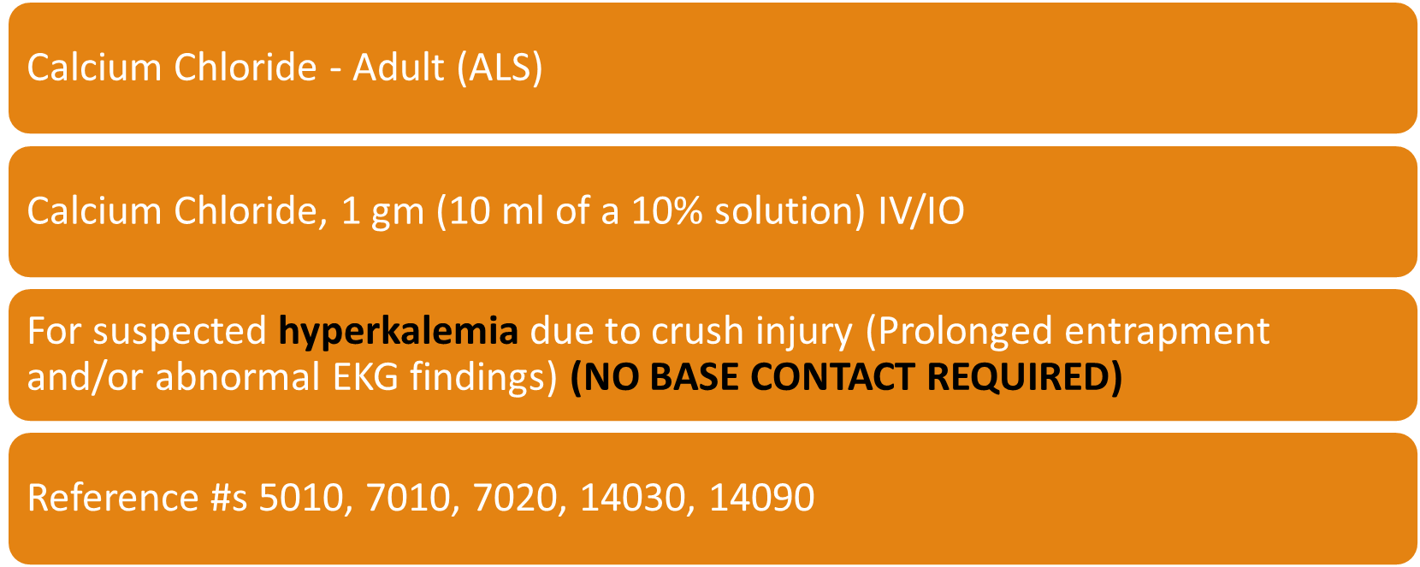
Policy # 11010 Medication-Standard Orders –Crush Injuries Treatment

Slide 20
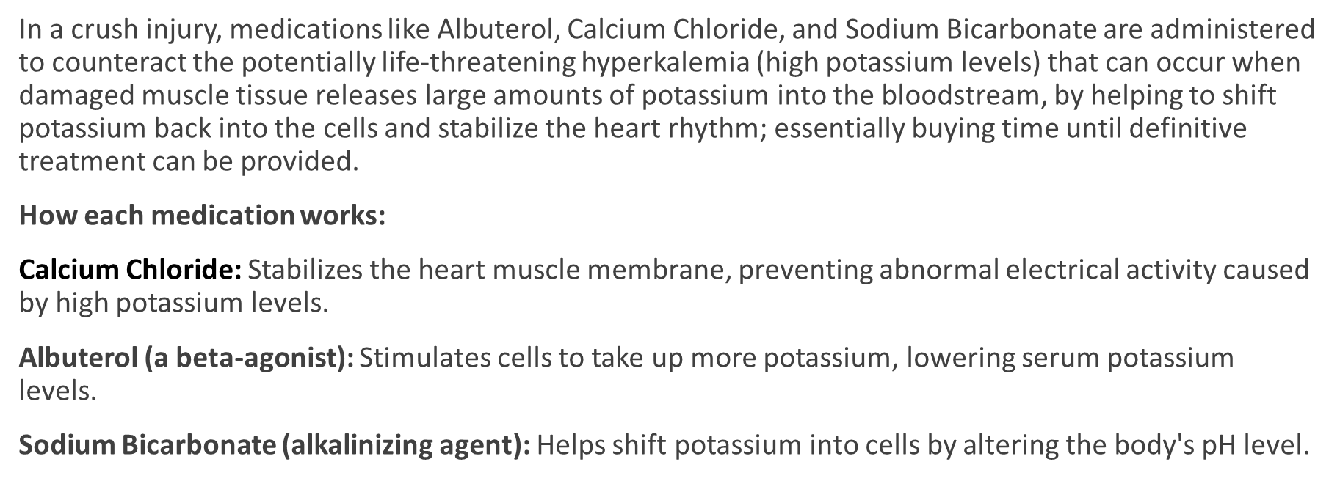
Why do we give these medications for crush injuries?

Slide 21

Policy # 11010 Medication-Standard Orders Continued-Still need Base Contact:
For End Stage Renal Disease (ESRD) patients on dialysis with suspected hyperkalemia and hemodynamic instability with documented sinus bradycardia,3rd degree AV Block, 2nd degree Type II AV Block, slow junctional and ventricular escape rhythms, or slow atrial fibrillation.
(Base Hospital order only).
Calcium Chloride, 1 gm (10 ml of a 10% solution) IV/IO
Reference #s 5010, 7010, 7020, 14030

Slide 22
References
“Davis’s Drug Guide Online + App | DrugGuide.com.” Www.drugguide.com, www.drugguide.com/ddo?svar=a%7cub&svar=c%7crc. Accessed 16 Sept. 2024.
Severe crush injury in adults – UpToDate
ICEMA.net- POLICY AND PROTOCOL MANUAL 11.01.24.pdf
Pictures taken off the World Wide Web. 11.27.2024

Slide 23

Thank you from
San Bernardino County EMS Educators

