Slide 1

Smart Parents, Safe Kids
Prevention of Falls
Expert Presenter: Michelle Parker
Program Specialist and Safe Kids Inland Empire Coordinator,
Loma Linda University Medical Center and Hospital

Slide 2

Preventing Falls at Home
Furniture/TV Tipovers
Crib Safety
Bunk beds
High Chair Safety
Baby Walkers
Window Safety
Stair Safety
Notes:
SLIDE 2: Preventing Falls at Home
Say: We’re going to take a close look at each injury area to make sure you understand what the data tells us about injuries and what you can do to prevent these injuries. You will be learning about furniture and TV tipovers, bunk bed risks, high chair safety, baby walkers, window safety and stair safety.

Slide 3
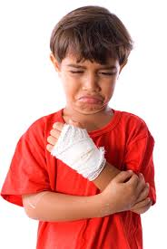
What’s the Problem?
Falls are consistently the #1 cause of hospitalization and emergency department visits in every age group age 0-19.
The vast majority of these injuries are preventable with education and low-cost environmental interventions that can be done at home by parents and caregivers.
California Department of Public Health, EpiCenter data http://epicenter.cdph.ca.gov/
Notes:
SLIDE 3: What’s the Problem?
Say:
Falls are the leading cause of non-fatal injuries for all children ages 0 to 19. Every day, approximately 8,000 children are treated in U.S. emergency rooms for fall-related injuries. This adds up to almost 2.8 million children each year.

Slide 4

Television and Furniture Tip-Over Safety
Right click to view video.
Notes:
SLIDE 4: Television and Furniture Tipovers
Say: Let’s begin with furniture and TV tipovers, which have been recognized as a major home safety hazard as TVs get bigger and heavier. Families used to have just one TV that all members of the family enjoyed together, but today you can find TVs in nearly every room of the house, making it harder to supervise children as they play around TVs. And as more families purchase new flat-screen TVs, the old TVs are recycled to bedrooms where children have greater access and even less direct supervision by parents. Unfortunately these old box TVs are often placed on top of dressers that are not secured to the wall – setting the stage for a potential disaster.
But it turns out that most parents just haven’t given much thought to securing their TVs. Let’s see what parents say. (Click on the image to go to a video clip.)

Slide 5
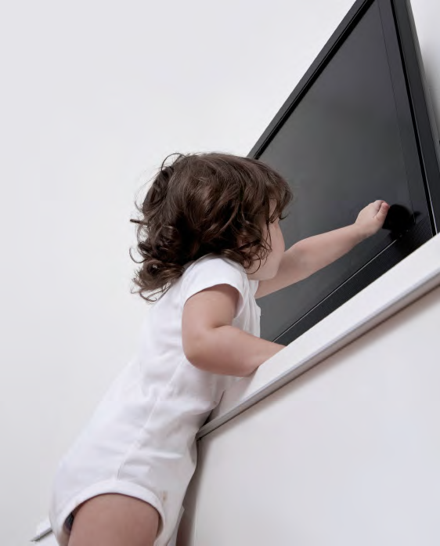
TV Safety: Why It Matters
Every three weeks a child dies from a TV tip-over
Every 45 minutes, a child is sent to the emergency department
31,000 injuries to children 19 and under annually – a 31% increase over past 10 years
Right click to view video.
Notes:
SLIDE 5: TV Safety: Why It Matters
Say: Let’s look at the data (read the slide)
Say: Although the data covers all children, who is at greatest risk? Why?
Let’s watch a video clip from the Today Show to learn more. (Click on picture to show video clip.)

Slide 6
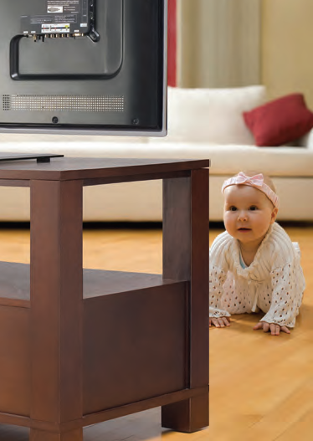
Who is at Greatest Risk?
Children 5 and under at greatest risk – 70%
A 36-inch CRT television falling three feet creates the same momentum as a 1-year-old child falling 10 stories
Bruises, scrapes, cuts
Internal organ injuries
Fractures
Head injuries
Death
Notes:
SLIDE 6: Who is at Greatest Risk?
Say: The injuries ER doctors see from these accidents are horrific. Because of the weight, sharp edges and inherent instability of flat screen TVs, these injuries are occurring far more frequently than ever before.
Say: Toddlers are naturally attracted to the TV images, the buttons, and the sounds – but obviously lack the coordination and judgment to avoid injury if a device begins to fall.

Slide 7
2001-2011 Television Tip-Over Related Injuries Among Children by Age
Notes:
SLIDE 7
Say: As you can see from the pie chart, children 5 and under are far more likely to be injured and, in fact, make up 72% of all injuries related to TV tip-overs. Children ages 6-9 make up 17% of those injuries.
Say: What are some of the reasons this might be happening? (ask your audience to come up with ideas)
Children are attracted to TVs and want to play with the buttons
Flat screen TVs are unstable and tip easily if they are not secured.
Children climb up to reach attractive objects that are set on or near TVs. They will climb up on a piece of furniture by pulling out drawers to reach a stuffed animal or other item that interests them, which could cause not only the TV, but the entire piece of heavy furniture to topple over.
There are more TVs in different rooms of the home, so young children have more access
Young children copy what they see adults doing. If they see you controlling the TV, they want to do the same thing.
Children rough house and wrestle – they can accidentally knock over an unsecured TV.
A playful dog can easily jump and knock over a TV.

Slide 8

How Tip-overs Occur
Flat-screen TVs placed on high, unstable, narrow-based platforms
Top-heavy, can easily be pulled off entertainment center, table, or TV stand
Mechanism of tip-over
  70% report no stated impetus for the fall
  18% report child pulled furniture onto himself
Most accidents occur in living room
4-8 pm
Notes:
SLIDE 8
Say: Flat screen TVs are inherently unstable and top-heavy with small, narrow platforms. An unsecured flat screen TV is far easier to pull over than an old, heavy box TV.
We know that most accidents occur in the living room between the hours of 4-8 pm. That is when mom or dad is preparing dinner, the baby might be cranky, and the kids are burning off energy from a day in the classroom…the hours between 4 and 8 pm are busy times for families when there is a lot of activity going on and parents are distracted.
It is interesting that 70% of respondents reported no impetus for the tip-over. It could be that no parent or caregiver was in the room when it occurred, or that a cord was tripped over or pulled.

Slide 9
Proven Interventions
Assess stability of TVs in home
  Can kids/pets playing in room knock TV over?
  Can children climb to reach items on or near TV? Can they pull out drawers?
Secure TVs
  Mount flat-screen TVs to wall (follow manufacturer’s instructions)
  Place old-style TVs on low, stable furniture
Secure top-heavy furniture to wall
  Use brackets, braces, or wall straps to secure unstable or top-heavy furniture
  Install stops on dresser drawers to prevent them from being pulled all the way out
Rearrange household items
  Move heavier items to lower shelves
  Avoid placing remote controls, toys, food, other items where kids can climb to reach them.
Notes:
SLIDE 9: Proven Interventions
Say: The solution to TV tipovers is a simple one. Parents and caregivers must take the time to secure their TVs!
Do: In a parent workshop it is ideal to demonstrate how to secure a piece of furniture or your TV. Go to your local hardware store to explain how you are trying to educate families about the dangers of furniture and TV tip-overs. Invite a local hardware store owner to come to a parent workshop to demonstrate how to attach a TV to a wall or secure a piece of heavy furniture.
Say: All flat-screen TVs can be mounted to the wall and often come with wall-mounting equipment and directions. Top-heavy furniture can be secured to the wall with brackets, braces or wall straps.
Another good intervention is to install stops on dresser drawers to prevent them from being pulled all the way out – which can lead to a furniture tip-over. Drawer stops can be purchased at any hardware store inexpensively.
The older, heavier TVs that cannot be mounted easily should be placed on lower shelves.
Never place objects that are attractive to kids – like remote controls, food, candy, toys – on top of furniture that is not secured. Those objects can be an incentive for climbing.

Slide 10
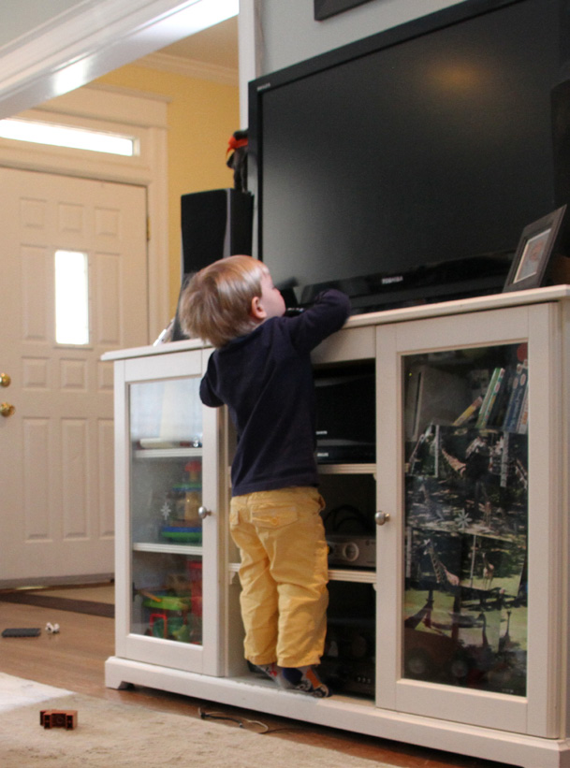
Take a Closer Look: Chance and Keisha
Right click to view video.
Notes:
SLIDE 10: Take a Closer Look: Chance and Keisha
Say: I want to leave you with this short video segment in which a mom tells her own story of a TV tip-over. TV tip-overs don’t just happen to other people, they can happen to anyone who has small children and unsecured TVs and large pieces of furniture.

Slide 11
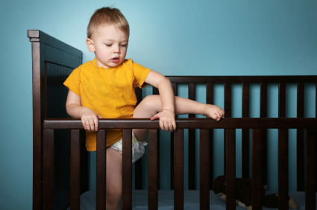
Preventing Falls: Crib Safety
PROBLEM
10,000 children under 2 arrive in emergency rooms every year from injuries suffered in cribs, playpens, bassinets
Most falls (83 %) caused when kids climb out of cribs and fall to the floor
Top heavy and land head first
SOLUTION
Ensure crib meets current standards – no drop sides
When child can pull himself up, lower the mattress height – 26” between top of mattress and top of rail
At 35” tall, child should transition from crib to toddler bed
Notes:
SLIDE 11: Crib Safety
Dr. Gary A. Smith, Director of the Center for Injury Research and Policy at Nationwide Children’s Hospital in Columbus, Ohio, says that these numbers are an underestimate. And because children of crib-age are top heavy, they generally fall head first and lack the ability to break their fall. So these injuries can be very serious – over 40 percent of injuries are to the head and neck.
Cribs with drop sides have been banned by the Consumer Product Safety Commission, so parents need to be very careful with hand-me-down cribs. Don’t use a crib with drop-down sides.
And definitely, once the child can pull up to stand and begins to develop other motor skills, parents should lower the mattress height to 26” from the top of the mattress to the top of the rail. If the child is able to climb out of the crib, it’s time for a toddler bed, which is usually around age 2 or when the child reaches 32” tall.

Slide 12

Preventing Falls: Bunk Bed Safety
Children love bunk beds, but they can be dangerous. The child in the top bunk can fall out, and the child in the lower bunk can be injured if the upper bunk collapses.
Notes:
SLIDE 11: Preventing Falls: Bunk Bed Safety
Say: Bunk beds? How many of you had bunk beds as a child? Of those of you who had bunk beds – or who had friends with bunk beds – can you remember any accidents or near-accidents that resulted from goofing around on a bunk bed? (Allow group sharing.)
Well, many of us loved bunk beds or always wanted one if we didn’t have one. Plus, they are great space savers and make it easier for two children to share a small room. Who has bunk beds in their home right now?
How is it going? (group share.)
If you have a bunk bed in your home now or decide to get one in the future, here are some facts you should know first.

Slide 13
Bunk Bed Safety: Why It Matters
Nearly 36,000 children and adolescents are treated for bunk bed-related injuries in emergency rooms each year.
Half the injuries occurred in children under 6, but there also was a surprising jump in accidents among 18- to 21-year-olds, who were more than twice as likely to be hurt as kids ages 14 to 17.
Nearly 3 of 4 injuries are caused by falls from bunk beds.
Half of victims suffered injuries to the head, neck or face.
60 % of injuries occurred to boys.
Source: “Journal of Pediatrics” June 2008
Source: 2008 study by the Center for Injury Research and Policy at Nationwide Children's Hospital's Research Institute
Notes:
SLIDE 12: Bunk Bed Safety: Why It Matters
(Read the slide.)
Say: Of children who fall from bunk beds, those younger than 3 were 40% more likely to sustain head injuries than older kids. Because they have a high center of gravity, young children tend to fall head-first.
Say: 30 percent suffered serious cuts, nearly a quarter reported bruises and scrapes and about 20 percent suffered fractures. More than 10 percent sustained concussions.
Say: It is likely that the uptick in accidents among college age youth is due to unsafe bunk beds in dorm rooms or unsafe behavior (i.e. drinking)
This data shows a clear need for parents to pay greater attention to bunk bed safety.

Slide 14
Bunk Bed Safety Tips
Do not allow a child younger than 6 years to sleep in the top bunk.
Place bunk beds in a corner with walls on two sides.
Make sure the top mattress fits snugly within the frame and cannot ride over the edge.
Attach ladder or stairs to top bunk, which should be surrounded by a guard rail.
Slats on guard rail should have a space no wider than 3 ½ inches between guard rail and side of mattress
Make sure mattress supported by wires/slats that run directly underneath and are fastened at both ends.
Use a night light.
Notes:
SLIDE 13: Bunk Bed Safety Tips
Say: This slide provides safety tips that you should consider if you have bunk beds in your home or if you plan to install bunk beds.
(Read the slide.)
Say: Most children under 6 years do not have the coordination to climb a ladder safely or keep from falling out. It is especially unsafe at night when a sleepy child gets up to use the bathroom.
Say: Corner bunk beds are better braced and reduce the number of sides where a child could possibly fall out
Say: A night light will help a sleepy child when he/she gets up in the middle of the night.

Slide 15
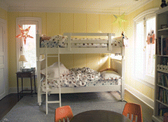
Bunk Bed Safety Tips
Establish no roughhousing rule
Closely supervise your child’s indoor play
Don’t allow young children to close their bedroom door if other children are visiting
Notes:
SLIDE 14: Bunk Bed Safety Tips
Say: Bunk beds are such an attractive hazard, it’s important to establish guidelines as soon as a child gets a bunk bed. When other children come over to play, their natural tendency is to take advantage of a fun play alternative that they might not have at home. So be very clear about NOT playing on a bunk bed. And of course this rule is much easier to enforce if kids are required to keep their bedroom doors open when other children visit. It makes it much easier for you to see and hear what’s going on.
Be sure to make rules clear to babysitters as well. Often the tendency to roughhouse increases when a babysitter is in charge, so make your house rules clear so there are no misunderstandings or accidents that could have been avoided.

Slide 16

Preventing Falls: High Chair Safety
Children should be safest in a high chair
Parent should be supervising at ALL times
Using the tray as a restraint is not enough
Notes:
SLIDE 15: Preventing Falls: High Chair Safety
Say: High chairs have turned into another source of preventable accidents. There is no denying that high chairs are an important fixture in the home of families with young children, but parents and caregivers need to make sure their high chair is safe and that an adult is supervising the child at all times. A high chair is not a substitute babysitter.

Slide 17
High Chair Safety: Why It Matters
High chair-related injuries increased by more than 22 percent between 2003-2010
9,400 high chair-related injuries treated annually in emergency rooms
Concussions most common diagnosis as children fall onto hard surfaces such as tables, floors or counters
Two-thirds of injured children were climbing or standing in the chair
Nationwide Children’s Hospital study, 2010
Notes:
SLIDE 16: High Chair Safety: Why It Matters
(Read the slide.)
Say: These statistics are shocking because children should be safest in their own high chairs, yet according to this data 1 child is injured every hour of every day in a high chair-related injury.
Say: Injuries from high chair falls are particularly devastating because the child falls from an elevated surface onto generally a very hard surface, and concussion is the most common result.
Say: Have any of you had the experience of seeing your toddler squiggling out of his or her high chair? Can you share your experience? (group share)
Say: The most important lesson to be learned here is that children in high chairs must be supervised at all times. They should not have an opportunity to “escape” from the high chair and the high chair should never be used as a restraint or a babysitter while the parent or caregiver leaves the room.

Slide 18
High Chair Safety Tips
Make sure the high chair you use cannot be tipped over easily and is in good repair
Make sure a folding high chair is locked in place every time you set it up
Whenever your child sits in the chair USE THE SAFETY STRAPS, INCLUDING THE CROTCH STRAP
The tray is not a restraint
Never leave a young child alone and do not allow older children to climb on the high chair
Notes:
SLIDE 17: High Chair Safety Tips
(Read the slide.)
Say: Many of us use high chair from friends or relatives whose children have outgrown the chair. That’s fine, as long as you make sure the high chair is stable and safe. It should not be wobbly. Make sure all screws are tightened.
Again, it is important to remember that the tray is not a restraint. Unsupervised toddlers can climb out of the high chair, while young babies can slip down if there is no crotch strap.

Slide 19

Baby Walkers: A Dangerous Choice
Most walker injuries happen while adults are watching.
Parents or caregivers simply cannot respond quickly enough.
A child in a walker can move more than 3 feet in 1 second!
Walkers are never safe to use, even with an adult close by.
Notes:
SLIDE 18: Baby Walkers: A Dangerous Choice
Say: Baby walkers are never a good idea, especially in homes with even one step.
(Read the slide.)
Say:
Baby walkers are a very dangerous choice for parents to make. The American Academy of Pediatrics recommends a ban on baby walkers, which have been banned in Canada since 2004. In a 2010 response to a question about baby walkers in the New York Times, consultant Pediatrician Dr. Alan Greene responded that use of walkers typically delays motor development and that walker use delays mental development even more. And that is in addition to the added dangers of moving faster, falling farther and reaching higher.
And back in 1994, the Consumer Product Safety Commission declared that baby walkers were responsible for more injuries than any other children’s product. The types of injuries included head injuries, broken bones, broken teeth, burns, entrapment of fingers and even amputations or death.

Slide 20
Baby Walkers: What’s the Problem?
Over 40 % of children who use baby walkers get hurt!
Injuries include:
Rolling down the stairs - 96 % of injuries
  Broken bones, severe head injuries
Burns
  Extended reach, easier to grab table cloths, pot handles, fireplaces, radiators
Drowning
  Easier to fall into bathtub
Poisoning
  Easier to reach high cabinets
Notes:
SLIDE 19: Baby Walkers: What’s the Problem?
Say:
The problem is that baby walkers give children mobility beyond their natural capability and faster than a parent’s reaction time. And according to Dr. Greene of the NY Times, babies who use walkers learn to crawl, stand and walk later than they would have otherwise, and continue to show delayed motor development for months after they have learned to walk. The delay seems to be a little more than three days for every 24 hours of total walker use.
Walkers place babies in an unnatural position, positioning them higher and better able to reach objects that would otherwise be out of their reach. In other ways, walkers put babies in harm’s way.

Slide 21
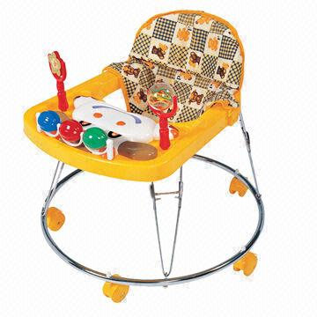
Baby Walker Safety Tips
Do not buy a baby walker!
Throw out the walker if you already have one!
Make sure there are no walkers wherever your child is being cared for
Notes:
SLIDE 20: Baby Walker Safety Tips
(Read the slide.)
Say: You can find safer alternatives to the baby walker that keep your child busy and entertained. Try activity centers that look like walkers, but without wheels. Play yards or play pens are safe areas where children can practice sitting, crawling, standing or walking. And a high chair is fine, too, as long as you use the safety straps and provide continuous supervision. Children enjoy playing with toys on the tray, making high chairs a good choice if you are working in the kitchen and want to make sure your baby is occupied and not underfoot.

Slide 22
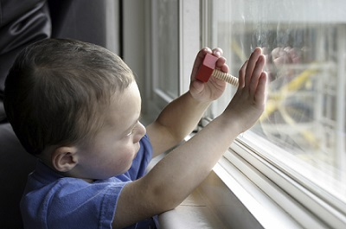
Window Safety
Preventing falls out of windows is as important as learning how to use a window in an emergency.
Notes:
SLIDE 21: Window Safety
Say:
Windows can serve as emergency escape routes in times of emergency, such as a fire. So it’s important to make sure your windows open easily from the inside and are not blocked by furniture or other objects.
Remember that security bars, grilles and grates not only keep intruders out, but they can also lock you in. The same is true for window guards, which will protect your children from falls. But there ARE good choices in window safety.

Slide 23
Window Safety: Why It Matters
Window falls cause 3,300 injuries per year to children ages 5 and under
One of every 3 children, on average, required hospitalization after falling from a window.
Kids push against screens
Climb onto furniture next to a window
Dramatic increase in spring and summer
Notes:
SLIDE 22: Window Safety: Why It Matters
Say: Window safety is a complicated issue. Windows are absolutely critical as an escape route in case of fire. But falls from windows are also a serious issue. On average, one of every 3 children required hospitalization after falling from a window.

Slide 24

One Mom’s Story
Thomas and Becca
Right click to view video.
Notes:
SLIDE 23: One Mom’s Story
(Click on the picture to play Becca’s story.)
Say: As Becca says, Thomas knew that screens are to keep bugs out, not keep kids in. But the problem is that even intelligent and well-behaved young children can’t really understand danger. A $9 window guard could have prevented this heart wrenching accident. Most parents don’t event think about it.

Slide 25
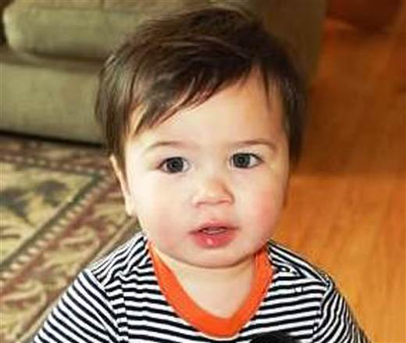
Window Cord Strangulation
Almost every month a child dies from window cord strangulation (right click to view video)
              The CPSC estimates that between 1996 and 2012, 1,590 children were treated for injuries, including brain damage, caused when they became entangled in these cords.
              SOLUTION: Cordless window blinds
Notes:
SLIDE 24: Window Cord Strangulation
Say: Windows have another potential safety hazard – and that’s window blind cords, which can be the cause of strangulations. Erica Thomas found two-year-old Cormac strangled by a window cord in his bedroom.
(Read the slide.)

Slide 26
Window Safety Tips
Use window guards or window stops
Install window guards or window stops so that windows open no more than 4 inches
For windows above the 1st floor, include an emergency release device in case of fire
Never depend on screens (or rules!) to keep kids from falling
Whenever possible, open windows from the top
Keep windows locked and closed when not being used
Move chairs, cribs and other furniture away from windows
Use cordless blinds.
Notes:
SLIDE 25: Window Safety Tips
(Read the slide.)
Say:
Remember that window falls are predictable and therefore preventable.
In Oregon, falls from windows have dropped by half because of the Stop at 4 campaign. Go to www.stopat4.com to learn more.

Slide 27
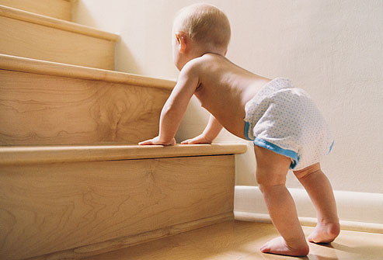
Preventing Falls: Stair Safety
8,000 children treated in emergency rooms every day for fall related injuries
Staircase most common place in home where falls occur
Notes:
SLIDE 26: Stair Safety
Say: Children of all ages love to climb stairs and play on stairs. Infants take special delight in conquering stairs as they improve their motor skills and develop a growing sense of independence. Yet we know how hazardous stairs can be for a toddler without hands-on adult supervision to prevent serious falls.
Say: According to the CDC, 8000 children are treated in ER’s every day for injuries related to falls. That’s nearly 3 million injuries a year.

Slide 28
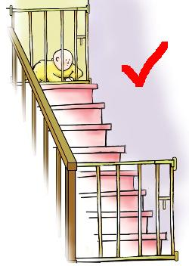
Preventing Falls: Stair Safety
SOLUTION
Baby gates at top and bottom of stairs
Expandable gate (pressure-mounted) at bottom of stairs only
Hardware mounted gate that can be opened and closed
No-hole baby gate mounting kits
Remove gates once your child can climb or open them
Keep stairs free from clutter to avoid fall and trip hazards
Make sure your baby gates are properly installed in the right place. Right click to view video
Notes:
SLIDE 26: Stair Safety
Say: A baby gate is the easiest and best way to keep infants and toddlers away from the stairs, and will hamper your child’s access even when you’re not watching. Expandable or pressure-mounted gates are easy and temporary to install, but only for use at the bottom of a staircase. If a child pushes or leans against a pressure mounted gate, the child’s weight may cause the gate to slip and fall. A subsequent fall from the top of the stairs poses a far greater danger than a fall at the bottom.
If you need frequent access to the stairs, a hardware mounted gate that can be opened and closed easily with one hand is the best option; it will allow you to carry your child, toys or laundry in one hand and open the gate with the other.
Be aware that the gates themselves can be the cause of injuries, so make sure you remove the gate once your child can climb or open it. Watch the video to learn more about baby gate safety.

Slide 29
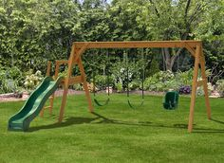
Preventing Falls: Outdoor Toys and Swing Sets
Swing Sets/Climbing Structures
Complies with current safety standards
Hardware is solid, screwed in tight and not rusted, no broken pieces or sharp edges.
After transporting check for loose or lost hardware.
Make sure product is correctly assembled and securely anchored
Place on flat, soft surface or playground surfacing to minimize impact of falls.
Notes:
Make sure the item complies with current safety standards for home playground equipment

Slide 30
Sources
National Fire Protection Association
National Safety Council
American Academy of Pediatrics, healthychildren.org
American Academy of Pediatrics, Parent Plus
American Architectural Manufacturers Association
National Wood Window and Door Association
Screen Manufacturers Association
Parent.Guide
Pediatrics, 2.17.11
National Electronic Injury Surveillance System, 1990-2008
Notes:
SLIDE 26: Sources

Slide 31
QUESTIONS?
Notes:
SLIDE 27: Questions

Slide 32
Thank You
Michelle Parker, 909-558-8118
mparker@llu.edu
Katie Smith, 916-244-1964
ksmith@thecapcenter.org
safekidscalifornia.org
facebook.com/safekidscalifornia
Notes:
SLIDE 28: Thank you

