Slide 1

Hospital
Emergency
Response
Team
By Loreen Gutierrez RN & San Bernardino County EMS Educators

Slide 2



Goals
The EMS Provider will understand when and how the Hospital Emergency Response Team (HERT) is initiated and how they respond.
Notes:
Physician responds to the scene.

Slide 3
Objectives
The EMS provider will understand how to request HERT.
The provider will determine when appropriate to use HERT.
The EMS provider will understand response times and what is entailed with deployment.

Slide 4
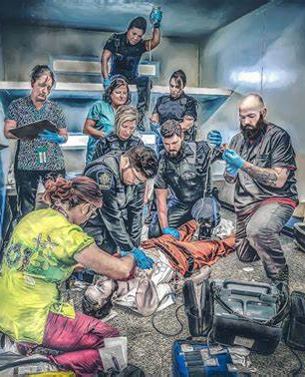

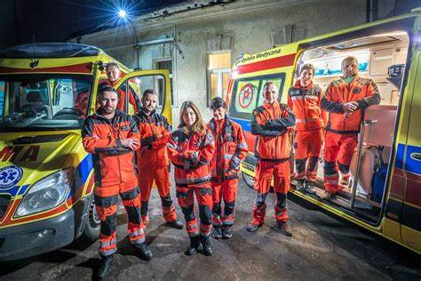


What is HERT?
HERT is requested by on-scene EMS providers.
HERT is utilized for life-saving not time-saving procedures. Example: amputation due to inability to extricate.
Hospital team is ready to respond within 20 minutes to a request
HERT provides life-saving surgical intervention, specializes in significant traumatic injuries, limb entrapment, prolonged extrication, and can provide blood products to manage life-threatening traumatic injuries.

Slide 5
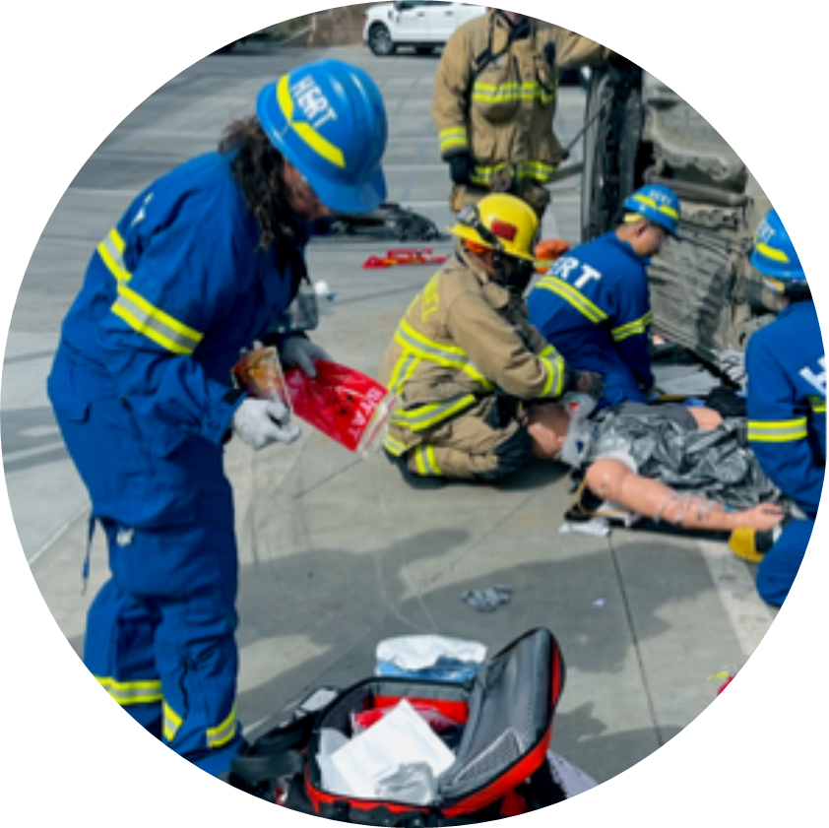
HOSPITAL EMERGENCY RESPONSE TEAM (HERT) Policy # 8060
PURPOSE
To establish a formal mechanism for providing rapid advanced surgical care at the scene, when a higher level of on scene surgical expertise is requested by the on-scene emergency medical services (EMS) provider.

Slide 6
PRINCIPLES
In general, a HERT is utilized in a situation where a life-saving procedure, such as an amputation, is required due to the inability to extricate a patient. Life before limb concept is utilized as a life-saving measure, not as a time saving measure.
HERT should be assembled and ready to respond within 20 minutes of a request with standard life-saving equipment in accordance with the HERT provider’s internal policy on file with ICEMA.
The standard life-saving equipment referenced above shall be predetermined, preassembled, readily available, clearly labeled, and stored in a predetermined location. Based upon the magnitude and nature of the incident, the standard life-saving equipment may require augmentation.

Slide 7
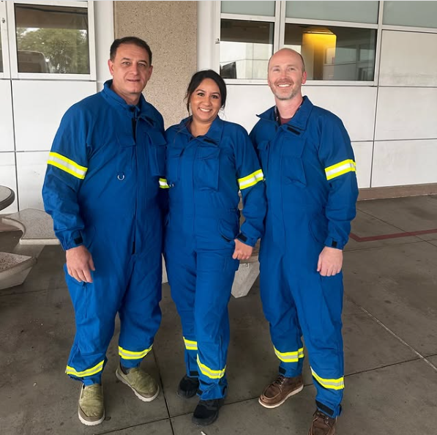
Components of a HERT
The HERT, will have a Physician Team Leader.
Activation of a HERT
Transportation of a HERT
Responsibilities of a HERT On Scene
Approval Process of a HERT

Slide 8
The Physician Team Leader:
Is responsible for organizing, supervising, and accompanying members of the team to a scene where a physician field response has been requested.
Shall be familiar with base hospital operations and the ICEMA’s policies, procedures, and protocols.
Is responsible for retrieving the life-saving equipment and determining if augmentation is required based upon the magnitude and nature of the incident.
Will determine the ultimate size and composition of the team based upon the magnitude and nature of the incident.
Will report to, and be under the authority of, the IC or their designee. Other members of the team will be directed by the Physician Team Leader.

Slide 9



HOSPITAL TEAM
ARMC & LLUMC will have predetermined, preassembled, readily available, clearly labeled life saving and safety equipment.
The HERT equipment will be stored in a predetermined, easily accessible location.
Notes:
The team is available at all times

Slide 10
HOSPITAL TEAM
The team leader is responsible for organizing, supervising and accompanying members of the team to the scene.
Must be familiar with base hospital operations & ICEMA policies
responsible for retrieving the life-saving equipment based on the nature of the incident
determines the size and composition of the team; usually composed of a Surgeon, licensed ED doc, registered nurse.

Slide 11
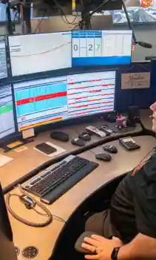
HERT ACTIVATION
The IC contacts Comm Center and requests HERT.
Early activation is encouraged when HERT would be useful or patient access is delayed.
Comm Center contacts the approved HERT provider.
Provides the pertinent information regarding the incident.
The team leader informs Comm Center when they are assembled, the number of team members, and transportation mode. Upon arrival to the incident, the team will report to the Incident Commander.

Slide 12
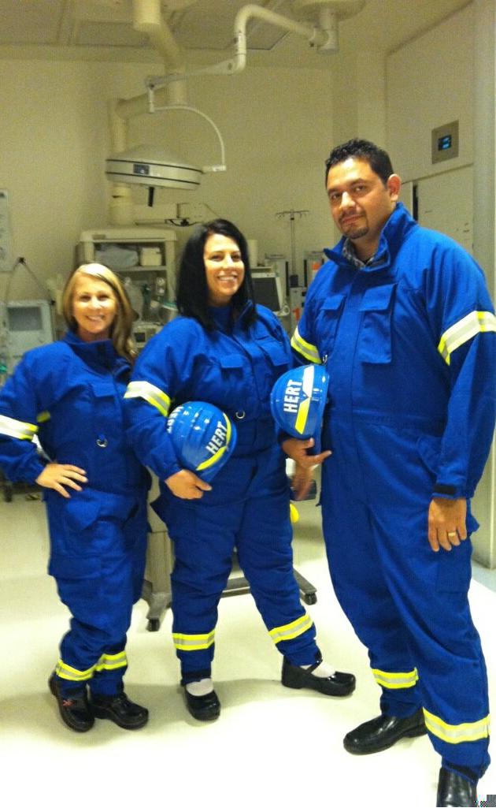
HERT ON SCENE
Team leader reports directly to the IC to access the emergency.
Don recommended Safety Gear
Documentation on scene.

Slide 13
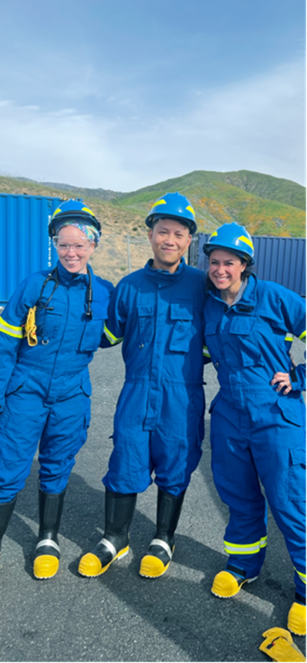
Gear on Scene
Scene safety, safety gear requirements; safety goggles, leather gloves, rescue helmet with HERT label, jumpsuit with HERT on back, Safety vests, safety boots. Documentation on trauma flow sheet.

Slide 14
Case Study: Traffic Collision
Participating agencies
Response
Colton Fire
San Bernardino County Fire
Arrowhead Regional Medical Center
American Medical Response
CHP
Pepe’s towing
911 dispatch to a traffic collision
8 vehicles involved
One vehicle on its roof
One badly damaged pick-up truck
First responders Arrive on scene 0503

Slide 15
Case Study Continued
Scene Assessment
ACTION
ACTION CONTINUES
Scene Safety Assessment
Triage
Set up IC
Declare MCI
Consult Extrication Group
Request Heavy Lift Tow
Contact Comm Center to request HERT Response
0515
HERT arrives at 0543
Patient in the pickup truck that is being extricated. Patient begins to decompensate before extrication, so life-saving measures are initiated.
the team waited in safe location for the patient to be extricated.
HERT members prepare for intubation prior to extrication, prepare for blood products prior to extrication.
Extrication complete 0643
Notes:
.

Slide 16

Summary
Dispatch updated units En-route, allowed for crews to order additional resources quickly.
Quick response from CHP on hard closing freeway.
H.E.R.T. had quick response to incident and was ablw to treat the patient on scene.
Objectives were completed despite challenges.
All personnel on-=scene worked cohesively and seamslessly.
No injuries to personnel working incident.

Slide 17
LESSONS LEARNED
Clear Understanding of Chain of Command.
Unknown Capabilities of HERT.
Comm Center education on:
Coordinating transportation to and from the incident.
Rotation of hospitals
Training needed between Fire Crews and HERT.

Slide 18
References
Loreen Gutierrez, RN – Special Thank you from San Bernardino County EMS Educators for the draft of this education piece. 01.28.2025.
ICEMA Policy and Protocol Manual Edition dated 11.01.2024
Pictures obtained from the World Wide Web 03.03.2025
Pictures LLUMC & ARMC HERT Teams. 02.05.2025

Slide 19


Thank You

