Slide 1
Midazolam in Pediatric Behavioral Emergencies

Slide 2
What is a Behavioral Emergency?
Patients that are violent, potentially violent, or who may harm themselves or others including EMS personnel.
Patients exhibiting dangerous agitation, confusion and hallucinations, erratic behavior, profuse diaphoresis, elevated vital signs, hyperthermia, unexplained strength and endurance, and behaviors that include clothing shedding, shouting, and extreme thrashing when restrained.

Slide 3



Behavioral Emergencies
True psychiatric emergencies in children are rare.
Do not always stem from mental illness
Are more likely to stem from situational problems
May be due to medical problems or injury

Slide 4

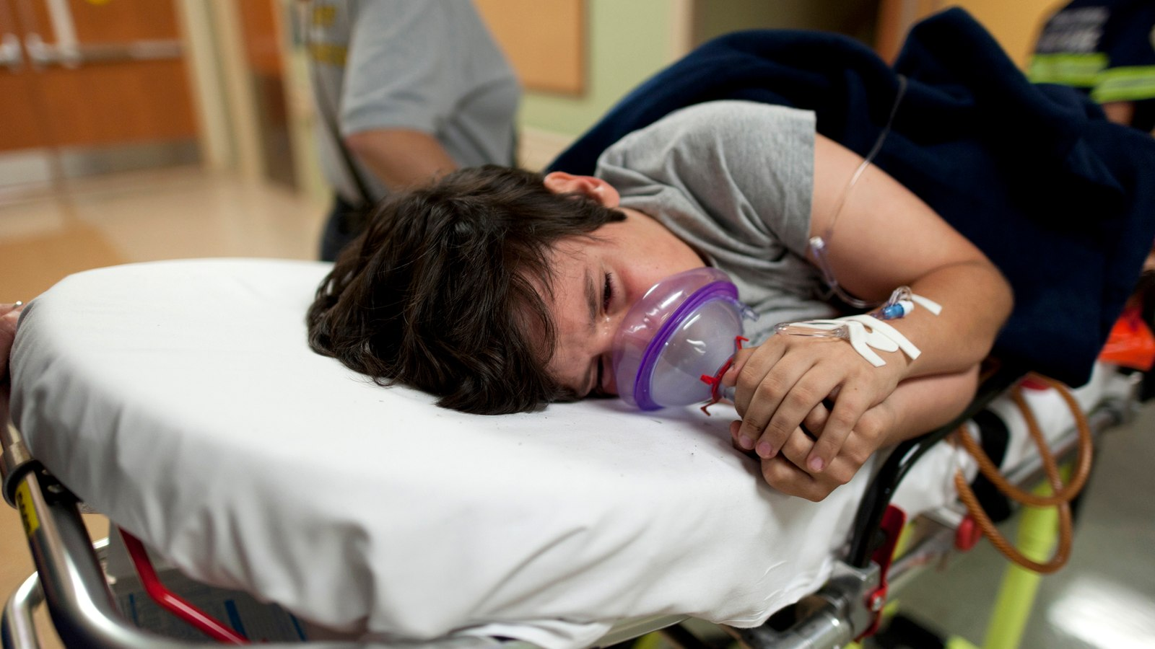

Chronic abuse or neglect
Normal emotional upheaval of adolescence
Behavioral emergencies may be
precipitated by stressful situations:
Unplanned pregnancy
Sudden traumatic event
Emotional upheaval that may not necessarily involve an emotional disorder

Slide 5
Medical Conditions/Injuries That Can mimic Psychiatric Illness
Seizure disorders
Hypoxia
Autism
Toxic ingestions
Street Drugs
DKA
Hypoglycemia
Brain injury
Meningitis
Encephalitis

Slide 6

What can be done in a Pediatric Behavioral Emergency…
Approach in a calm and cautious manner can help regulate the nervous system of the patient.
Maintain a safe distance
Approach the child in a calm, reassuring manner using a calm demeanor and tone of voice.
Attempt verbal de-escalation
Limit physical touch
Engage in active listening
Do not yell or lose control of your own emotions.
Strive to gain the child’s confidence

Slide 7
Indications for the use of Midazolam for pediatric Behavioral Emergencies #14110
If all attempts at de-escalation fail and the patient is excessively aggressive, exhibiting dangerous agitation, confusion and hallucinations, erratic behavior, and continues to be a threat to themselves and others, the need for physical restraints and medications may be necessary*.
NOTE - When a drug or medication it is used as a restriction to manage the patient’s freedom of movement and is not a standard treatment or dosage for the patient’s condition it is considered a chemical restraint.

Slide 8
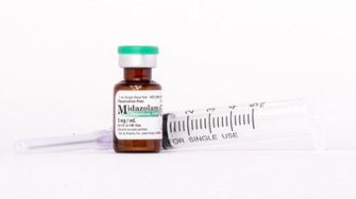
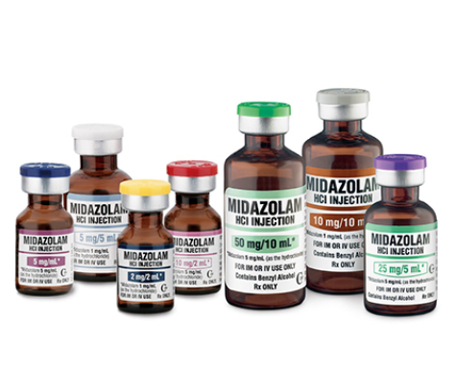
ICEMA Protocol #11010
Midazolam can be used in Behavioral Emergencies, if patient meets criteria for potentially fatal and dangerous agitation (Base station contact necessary for patients <9yrs old)
Midazolam, 0.1 mg/kg IV/IO (Max 2.5mg) - May repeat in five (5) minutes or
Midazolam, 0.2 mg/kg IM/IN (Max 5.0mg) - May repeat in 10 minutes.
Assess patient for medication related reduced respiratory rate or hypotension.
Maximum of three (3) doses using any combination of IV/IO/IM/IN may be administered. Not to exceed adult dose.
Contact base hospital for additional orders and to discuss further treatment options.
Do not administer any medication you did not draw up.

Slide 9
After you give Midazolam…
Place on cardiac monitor - continuous monitoring of a patient after administration of Midazolam is required.
Obtain capnography - monitor waveform and numerical value. Apnea can be the result of the use of Midazolam and other medications.
Once conditions are safe, establish IV.
Base hospital may order Sodium Bicarbonate for potentially fatal and suspected metabolic acidosis/hyperkalemia - administer per ICEMA Reference #11010.

Slide 10
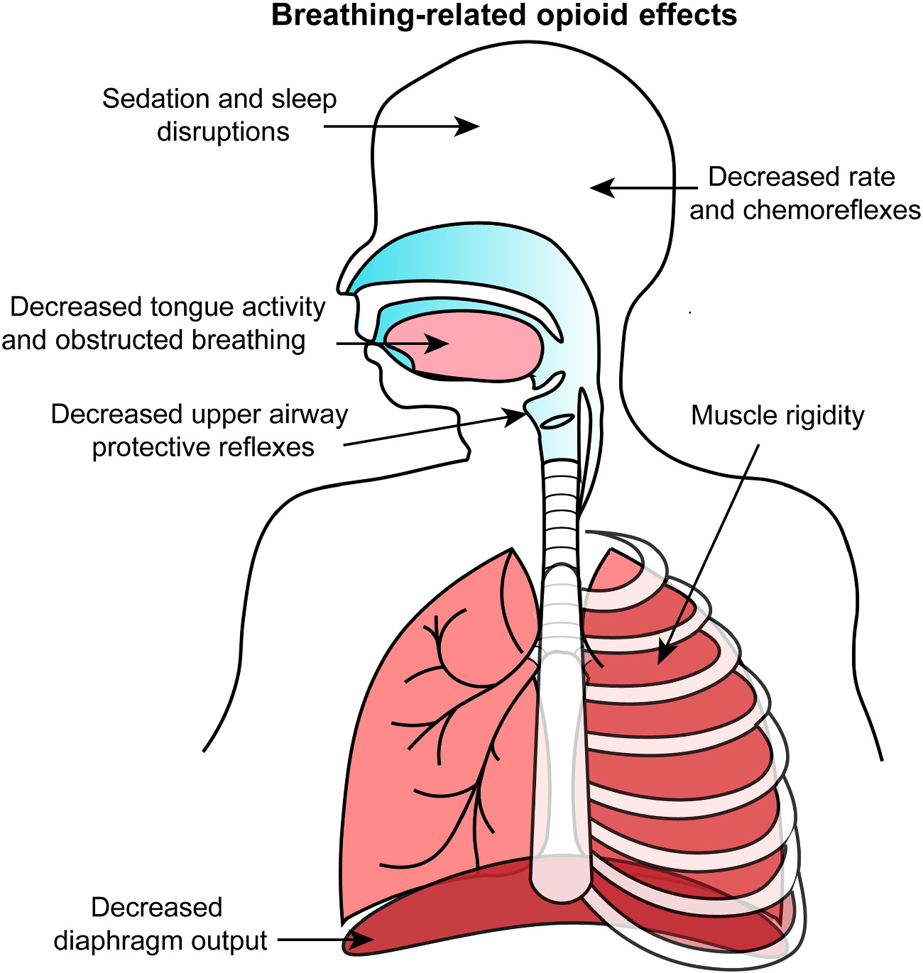
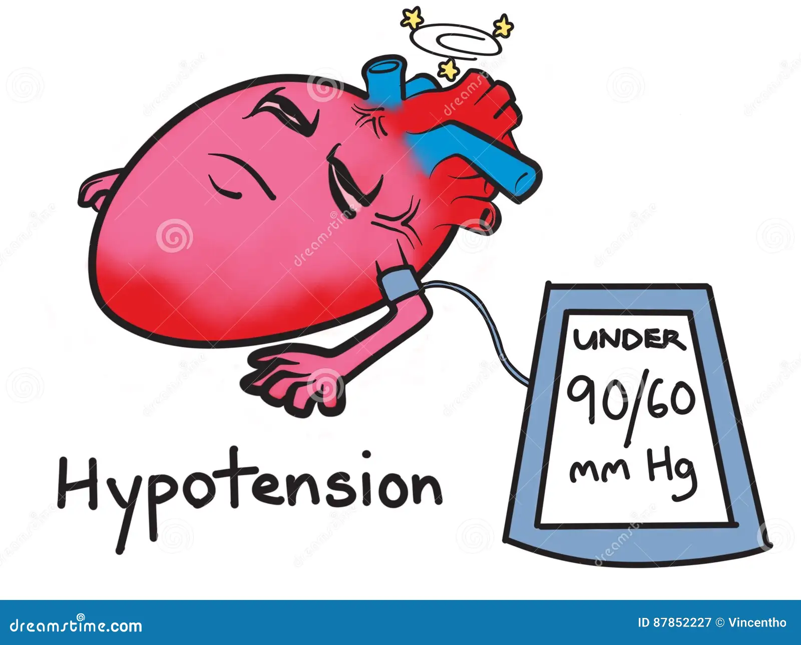
Things To Watch out For:
In route to the hospital continually monitor and assess patient for:
Respiratory depression
Hypotension

Slide 11

Document, Document, Document!
Date and time medication was given including injection site, in the medication tab.
In the narrative, document the events leading up to the need for medication, including all alternative interventions attempted.
Follow ICEMA process for wasting all controlled substances.

Slide 12
References
ICEMA Protocol Manual 11.2024
Pictures taken off the World Wide Web. 2024

Slide 13
THANK YOU!
Gigi Rodriguez, RN, BSN, CPEN, MICN
Pediatric Emergency Care Coordinator
LLUCH Emergency Department
Collaboration San Bernardino County EMS Educators 11.2024.

