Slide 1

Sepsis
Education
EMS Educators 2024

Slide 2

Sepsis Protocol Purpose
To facilitate rapid identification and treatment of patients with suspected sepsis.
Decreasing mortality rates, improving the chance of survival.
Notes:
Sepsis is a complicated disease process that high a high mortality rate. Until the early 2000s, 50% of people would die. Over the past 15 years, we have learned more about the disease and enhanced therapy has greatly decreased mortality.
As of Feb 2020, the total annual hospital costs of treating sepsis in the United States are estimated at more than $24 billion / $18,244 per hospitalization. (Mayo Clinic, 2021)

Slide 3
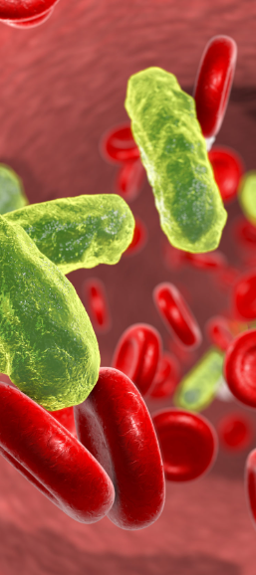
Definition
Sepsis is a life-threatening complication of infection.
Sepsis occurs when chemicals released in the bloodstream (to fight an infection), trigger inflammation throughout the body.
Causes a cascade of changes that damage multiple organ systems, leading to failure, potentially resulting in death.

Slide 4

Goals and Objectives
Provide early identification of sepsis in the field, standardize identification and improve patient outcomes in the communities we serve.

Slide 5
Sepsis Spectrum
SIRS
Sepsis
Severe Sepsis
Septic Shock
HR>90
RR>20
T > 100.4 F or < 96.8 F
Abnormal WBC count
Low pCO₂
2 SIRS
Infection
+
Sepsis
-Hypotension
-End organ damage
-Elevated lactic acid
Severe sepsis and persistent signs of end organ dysfunction
criteria
Mortality 50%
MORTALITY

Slide 6
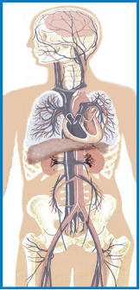
Multiple Organ System Dysfunction
CNS
Altered mental status
Cardiovascular
Tachycardia
Hypotension
Respiratory
Tachypnea
Hypoxia
Renal
Oliguria
Anuria
Renal failure
Hepatic
Jaundice
Liver inflammation
Coagulopathy
Hematologic
Consumptive coagulopathy
Petechiae
Purpura
Metabolic
Lactic acidosis
Notes:
Sepsis occurs when the inflammatory processes of the body in response to an infection exceed the boundaries of the local environment. The immune response becomes more global, more generalized to all parts of the body. It becomes uncontrolled, unregulated, and self-sustaining (domino-effect).
This generalized inflammation causes wide-spread cellular injury. Cells are unable to perform their functions efficiently, leading to organ dysfunction. Tissue ischemia (low blood flow) results from a mismatch in available oxygen to changing tissue oxygen needs. The body responds by secreting catecholamine (fight or flight) hormones like epinephrine to compensate. The body produces lactic acid as it uses epinephrine to help jump start energy production.
Mortality is high in septic patients with elevated lactic acid levels.
Different criteria of what constitutes organ dysfunction have been defined for each organ system. These criteria are used in many ways when treating sepsis, primarily in identifying the severity and progression of sepsis.

Slide 7

34% of patients presenting to the ED with a serious infection arrived by EMS
In these patients, the mortality rate was better for EMS patients (8%) than non-EMS patients (2%)
Notes:
This study observed that of all sepsis patients, the ones brought in by EMS were more likely to be elderly, from a nursing home, have abnormal vital signs, have an elevated lactic acid, and have organ dysfunction.
In other words, EMS gets the sickest of the sick!

Slide 8


Special Considerations
Prioritize early recognition!
Decrease time to intravenous fluids
Decrease time to antibiotics
Decrease mortality
SEPSIS ALERT
Communicate your suspicion early!
Explicitly communicate abnormal vitals (especially temp) to prepare the receiving
Notes:
Some hospitals recognized EMS-initiated sepsis alerts like stroke, STEMI, and trauma alerts, and others may not.
IT WON’T MATTER TO YOU AS THE EMS PROVIDER!
It may help save a life just because you explicitly communicate your concern for sepsis to the accepting facility!
Early notification of the hospital will help trigger the process of more aggressive care.
As they say, attitude is infectious. Your heightened tone of alarm gets attention from others and helps combat the systematic inertia that can doom a septic patient.

Slide 9
Causes of Sepsis
Begins with a primary infection.
When an infection is not stopped by the immune system or pharmaceuticals, sepsis can occur.
Onset typically due to bacterial infections, but can also be from influenza, viral and fungal infections.

Slide 10
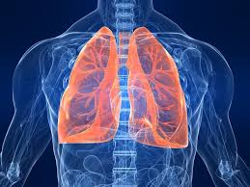
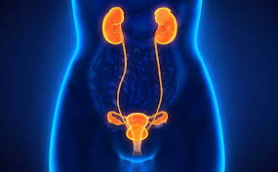
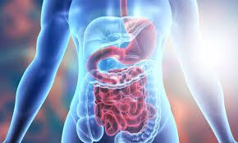
Where do the infections start?
Mode of infection commonly occurs in:
Lungs
Urinary tract
Skin
GI tract

Slide 11
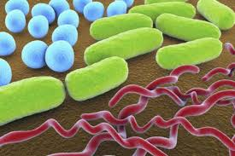
Common Bacteria
Single-celled bacteria
Escherichia coli
Salmonella enterica
Shigella dysenteriae
Pseudomonas aeruginosa
Neisseria meningitides
Klebsiella and Streptococcus pneumonia
Staphylococcus aureus

Slide 12
Common Viruses
Respiratory Viruses:
Epstein–Barr virus, influenza and measles
GI Viruses:
Rotaviruses, poliomyelitis, hepatitis A, E and sometimes B
Skin Viruses:
Rabies, arboviruses in mosquito or tick bites, hepatitis B and C, smallpox, chicken pox, herpes simplex virus (HSV)

Slide 13
Common Fungi
Aspergillus affects people with lung disease.
Candida, causes thrush when it enters the blood stream.
Histoplasma, causes illness when spores enter the lungs.
Pneumocystis jirovecii, effects people who have impaired immune systems, particularly HIV/AIDS or using corticosteroids.

Slide 14

Epidemiology
49 million cases and 11 million deaths in 2017 (20% of all annual global deaths)
Hospital mortality=27% ICU mortality=42%
Low-middle sociodemographic indices make up approximately 85% of sepsis related deaths.
Avg. hospital-wide cost $32k per patient
Hospitalization of sepsis patient consumes more than $27 billion/yr.
Readmissions cost $2 billion/yr.
“Global report on the epidemiology and burden of sepsis”, World Health Organization, 2020
Sepsis Alliance, “Sepsis Fact Sheet”, www.sepsis.org, 2019

Slide 15

Data Epidemiology in PEDS
In 2017, almost half (20 million) of all sepsis cases worldwide occurred in children under 5 years old.
Estimated 15% of all neonatal deaths globally were due to sepsis.
2.9 million deaths among children younger than 5 years old (26.4% of all sepsis deaths).
Sepsis incidence was biphasic; it peaked in early childhood and again in elderly adults.

Slide 16
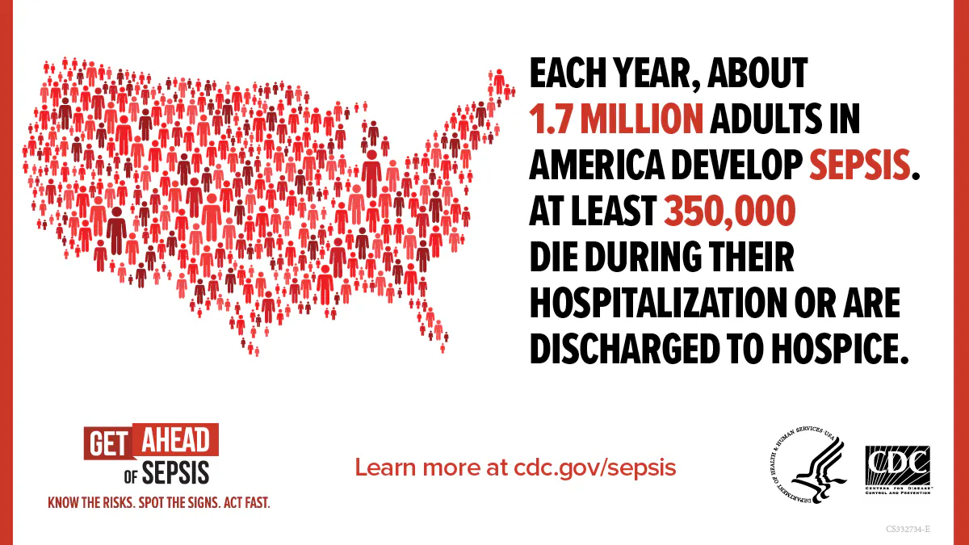
Sepsis patient data
19% of US hospitalized pts are readmitted within 30 days
40% of global patients are hospitalized within 90 days
Avg. 38 sepsis related amputations daily in US
50% of survivors left with long term physical and psychological effects
50% of survivors recover completely
33% die within a year
50% of these deaths were a direct complication from the previous sepsis episode
17% experience significant morbidity

Slide 17
Most vulnerable to sepsis?
Anyone with an infection is potentially at risk of having a septic reaction. There are other risk factors that can increase an individual’s chances:
      Chronic illness
      Diabetics
  Those who are immunocompromised
        Cancer, autoimmune disease, and transplant patients
Almost any infection can lead to sepsis
Most importantly, individuals with underlying health conditions are at a higher risk of developing an infection that could lead to sepsis.
Notes:
Having a chronic illness and not managing it properly can place an individual at risk of infection and sepsis. An example of a chronic illness that can leave a person susceptible to infections is diabetes. Not maintaining proper blood glucose levels can cause issues. High blood sugar levels has been linked to preventing oxygen and nutrients from energizing cells, and disrupting the normal function of the immune system. Diabetics are vulnerable to wounds and sores that can take a long time to heal. With extended recovery times, these wounds can become a source of infection that can lead to sepsis. Some individuals with a chronic illness might require the use of medical devices that either need to be inserted or used for extended periods. Some of these devices include: urinary catheters, feeding tubes, intravenous infusion devices, hemodialysis, and respiratory therapy equipment. Use of these devices expose the user to the potential of infection. It is important that the individuals follow recommended care for the devices to reduce the chance of infection.
Individuals with cancer or an autoimmune disease can receive treatment that can suppress their immune system and limit the effectiveness of how the body fights infection. Chemotherapy treatments meant to attack cancer cells can reduce the number of white blood cells. It is important for chemotherapy patients to distance themselves from other people in order to reduce the chance of acquiring a bacterial or viral infection. It is also important that these individuals seek medical treatment as soon as they believe they have an infection.
Transplant patients are at risk for an infection during and following their transplant surgery. The anti-rejection medications patients are placed on can reduce the effectiveness of their immune system and lead to infection.

Slide 18

Comorbidities include:
Cancer
Autoimmune disease
Chronic medical conditions (kidney disease, diabetes)
The body’s ability to fight off infection is impaired.

Slide 19


Special populations with increased risk
Adults 65 and over
Young children, including those under 1 year old
Pregnant and recently pregnant mothers
Cancer patients

Slide 20

Examples of Risk Factors
Indwelling catheters (foley, PICC line etc.)
Recent surgery
Open wounds
Bedridden or immobile patients
Compromised immune system due to comorbidities previously stated

Slide 21
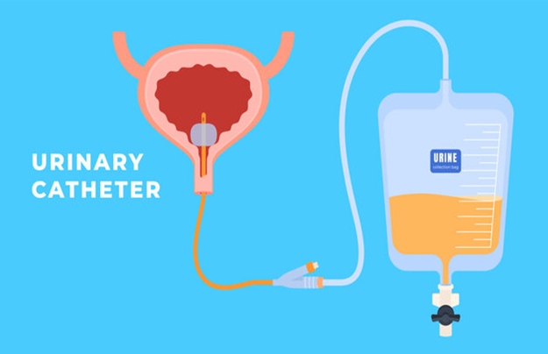
Indwelling Catheters
Potential site of infection, introduces organisms into the body.
Not easily assessed, especially in EMS.

Slide 22

Recent Surgery/Open Wounds
Organisms can infect a wound through various forms of contact.

Slide 23

Lack of Mobility
Complications include pressure ulcers, pneumonia and urinary tract infection.

Slide 24
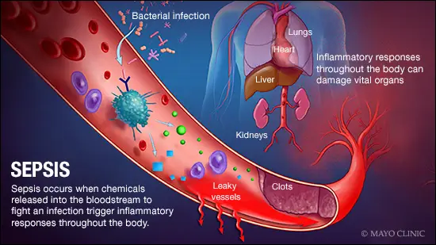
Effects of Sepsis

Slide 25

Systemic Inflammatory Response (SIRS)
Sepsis = SIRS, SIRS = Sepsis
When the response is caused by the presence of bacteria it is called Septicemia.
If left untreated, can lead to Septic Shock: a state of severe sepsis that leads to hypotension and poor tissue perfusion = organ failure.

Slide 26

Pathophysiology: Effects of A Complex Immunocompromising Process
Inflammation is the body’s natural response to a chemical, traumatic, or infectious insult.
Following an insult, local pro-inflammatory mediators, cytokines are produced and released.
Unregulated release of cytokines can elicit toxic reactions and promote cellular adhesion.
Cell damaging proteases are released (prostaglandins), leading to fever, tachycardia, ventilation/perfusion abnormalities, acidosis, and activation of the clotting cascade.

Slide 27
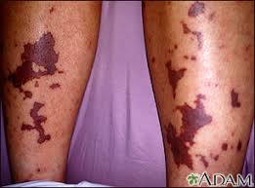
Pathophysiology of Sepsis:
The presence of wide-spread inflammation disrupts clotting mechanisms.
• DIC
Poor tissue perfusion leads to multisystem organ failure (MODS)

Slide 28
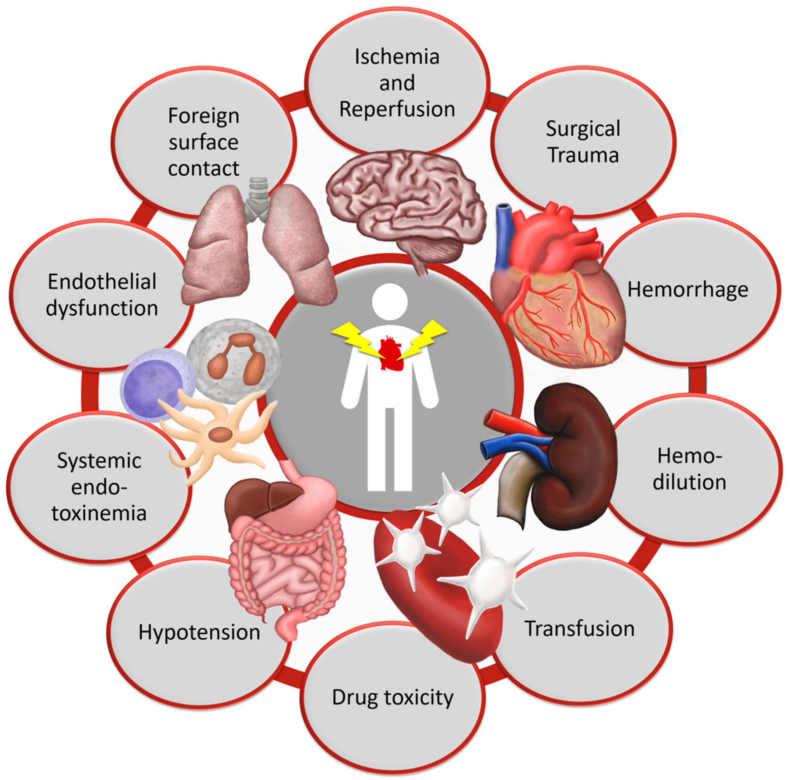
Pathophysiology:

Slide 29
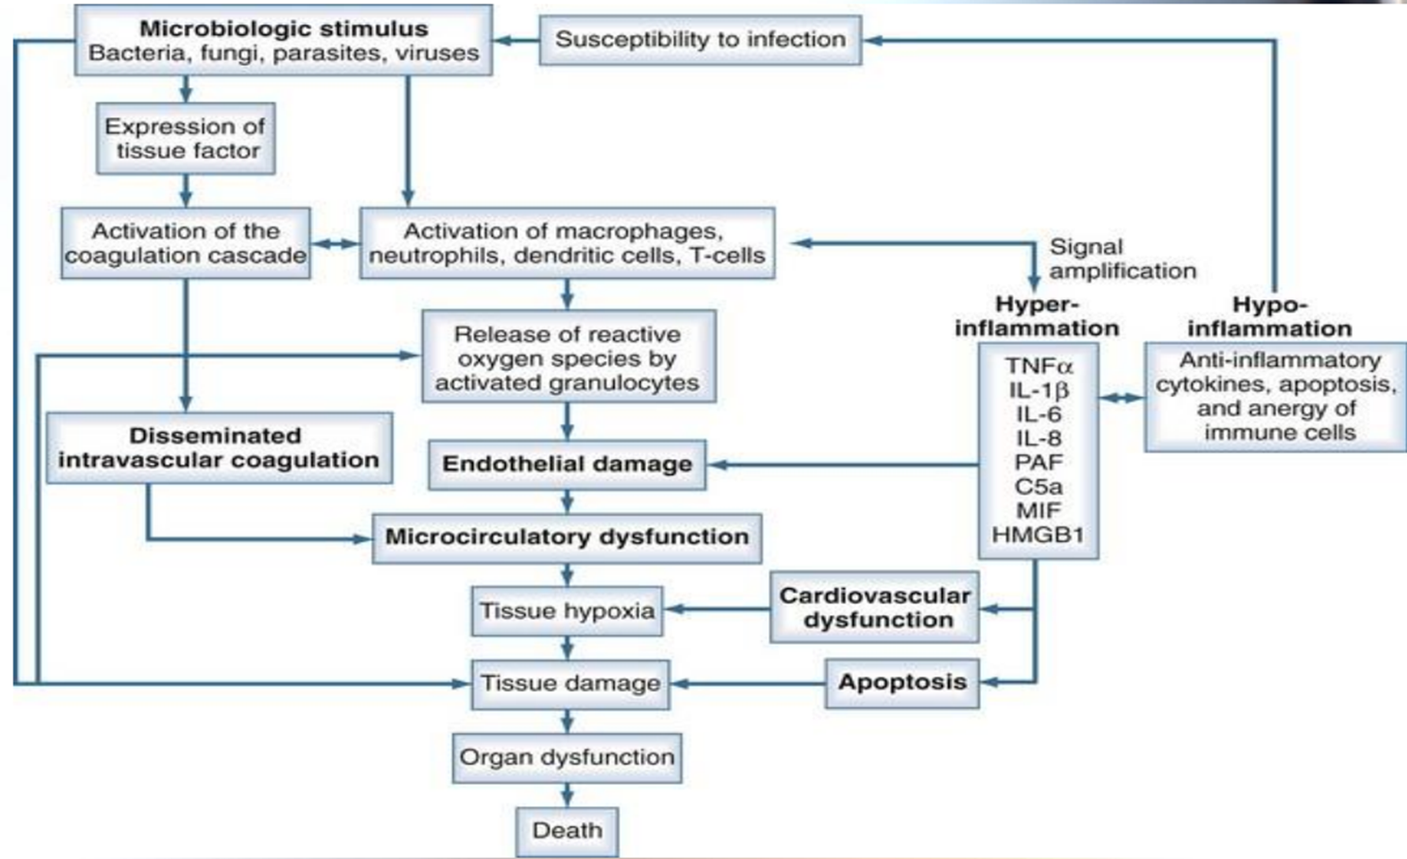
Continued

Slide 30
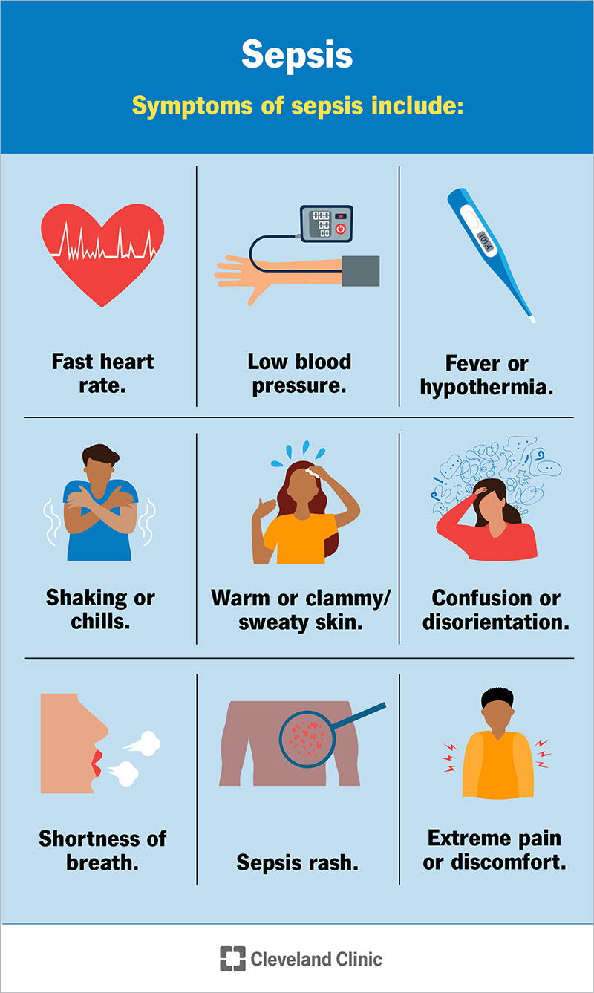
Clinical Signs & Symptoms
Fever
Chills
Cough \SOB
Fatigue
Dizziness
Headache
Dysuria
Flank pain
Abdominal pain
Joint pain, tenderness, body aches

Slide 31
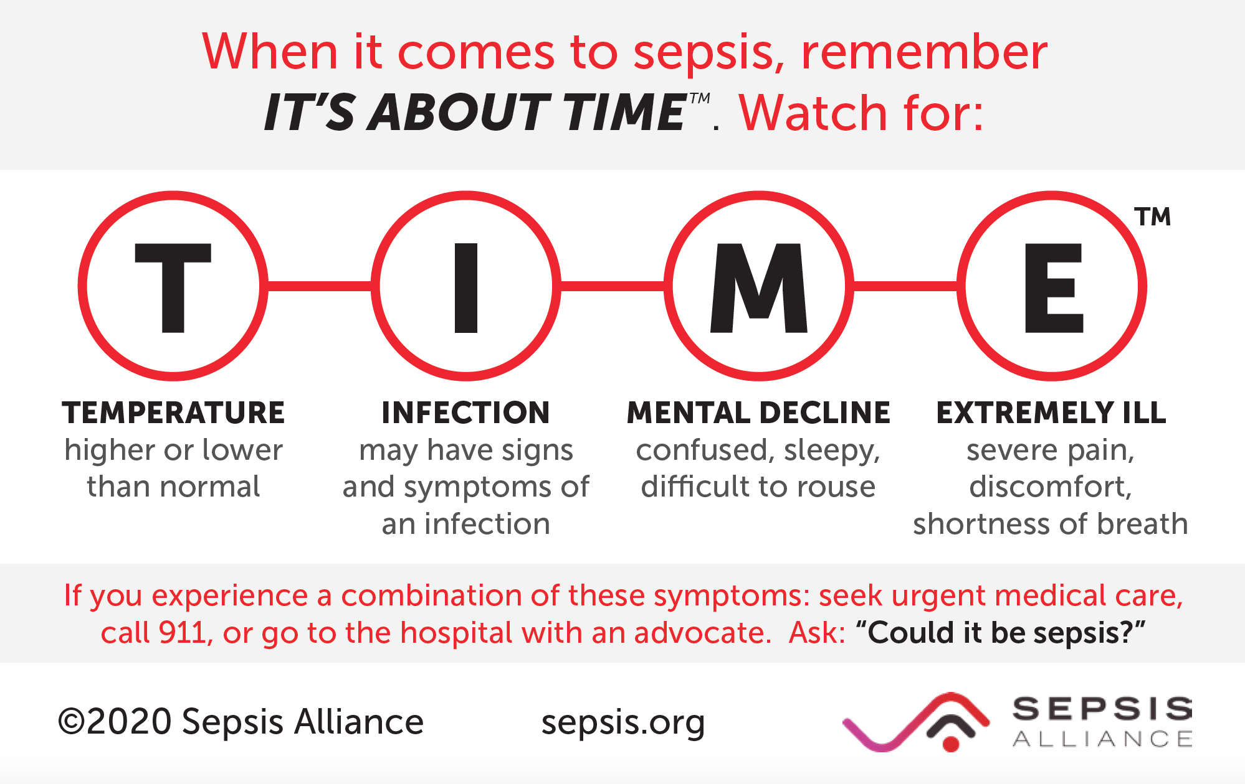
Duration
Sepsis can develop quickly from initial infection and progress to septic shock in as little as 12 to 24 hours

Slide 32



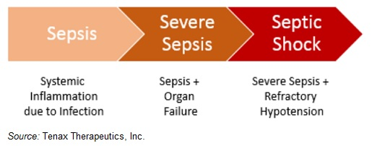

Three stages of sepsis
Sepsis progresses through distinct stages, each with specific clinical features.

Slide 33
Stage One
The initial stage when the body's response to an infection triggers widespread inflammation.
Symptoms may include fever, increased heart rate, increased breathing rate, and generalized weakness.
At this stage, the infection is typically localized to one area of the body, but the inflammatory response begins to spread.
Clinical Features:
Fever or hypothermia
Rapid heart rate (tachycardia)
Increased respiratory rate (tachypnea)
Altered mental status
Elevated or low white blood cell count (leukocytosis or leukopenia)

Slide 34
Stage Two
If not treated promptly, infection can progress to severe sepsis.
In this stage, the inflammation leads to organ dysfunction or failure, (kidneys, lungs, liver, or brain may be affected).
Clinical Features:
Hypotension (low blood pressure)
Difficulty breathing
Changes in mental status
Signs of end-organ damage (e.g., altered kidney function, decreased urine output, liver dysfunction)
Lactic acidosis
Coagulopathy (abnormal blood clotting)

Slide 35
Stage Three
The most severe stage of sepsis (septic shock), characterized by dangerously low blood pressure that doesn't respond to fluid resuscitation.
This severe drop in blood pressure can lead to inadequate blood flow to vital organs, causing them to fail.
Septic shock is a medical emergency and requires immediate treatment. Without prompt and aggressive intervention, it can be fatal.
Clinical Features:
Profound hypotension
Organ failure (e.g., acute kidney injury, respiratory failure)
Altered mental status
Poor tissue perfusion

Slide 36

How is sepsis diagnosed?
One should suspect sepsis when the following clinical signs are present:
The presence of infection
Profound hypotension and a rapid heart rate
Increased respiratory rate

Slide 37
How is sepsis diagnosed-continued:
Not one test to diagnose but...
A combination of blood tests are suggestive of sepsis.
Higher than usual white blood cells (indicating infection).
Elevated lactic acid (released when organs and muscles are starved of oxygen) .
Elevated creatine (indicative of kidney malfunction).
Elevated cardiac markers (indicating cardiac muscle injury).

Slide 38
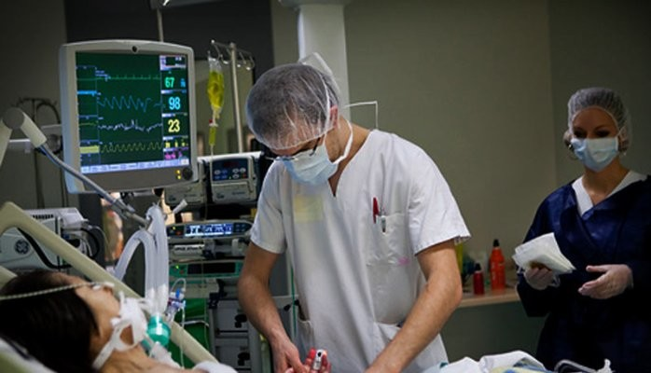
Hospital Treatment
Supportive care-CVP lines-ventilator
Medications- fluids, vasoconstrictors, antibiotics, blood pressure medications, and steroids.
Blood glucose and EtC02 monitoring.
Epidemiologist, Intensivists, Critical Care, Emergency room.
Notes:
Sepsis notes
All the findings together need to be reported to the receiving hospital to paint the full picture of sepsis, not just fever. ALOC, tachycardia, tachypnea, AND low etco2 25 mm hg or less with normal non-shark fin waveform, which is a huge indicator. Patients don’t have to be febrile to be septic (cold sepsis or more accurately sepsis vs. sirs) nor do they have to be tachypneic and tachycardic, especially when decompensated, but will generally be hypotensive and have ALOC.
Elevated BG in a non-diabetic is another good indicator and should be evaluated as part of the diagnostic (even though it can be a late sign of metabolic distress).
Decreased etco2 is indicative of elevated lactate levels. Tachypnea is not to be confused with hyperventilation when looking at low etco2. Aggressive fluid resus/push dose Epi if needed is paramount. Trying to maintain MAP of >65. PDEpi is a second-tier vasopressor for this but it’s what we have.

Slide 39
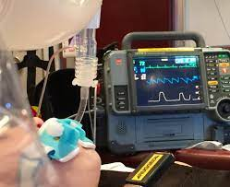
Pre-Hospital Treatment
ICEMA Protocol # 14280
Field Assessment/Treatment Indicators:
  For suspected infection and two or more of the following:
      Temperature > 100.4 F or 96.8 F
      Sustained HR> 90
      EtCO2 less than or equal to 25mmHg
      Sustained Respiratory rate>20

Slide 40
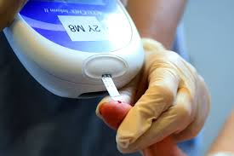
BLS Interventions
● Oxygen therapy as clinically indicated.
• Position patient as tolerated and cover to avoid shivering. If altered, place in left lateral position.
• Obtain and assess blood glucose level. If indicated, administer Glucose - Oral per ICEMA - Medication - Standard Orders.

Slide 41
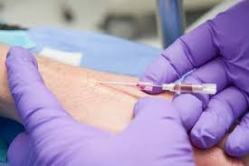
Limited ALS Interventions
• Perform activities identified in the BLS Interventions
• Obtain vascular access.
• Administer 500 ml IV bolus, may repeat one (1) time.
• If hypoglycemic;
Dextrose per ICEMA - Medication - Standard Orders, or
If unable to establish IV, Glucagon may be given one (1) time per ICEMA - Medication - Standard Orders.
• If hyperglycemic;
Administer 500 ml IV bolus may repeat one (1) time.

Slide 42
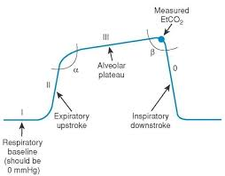
ALS Interventions
Perform activities identified in the BLS and LALS Interventions.
Place on cardiac monitor and obtain a 12-lead ECG as clinically indicated.
Monitor EtCO2
For profound hypotension, unresponsive to fluid boluses, administer Push Dose Epinephrine per ICEMA - Medication - Standard Orders

Slide 43
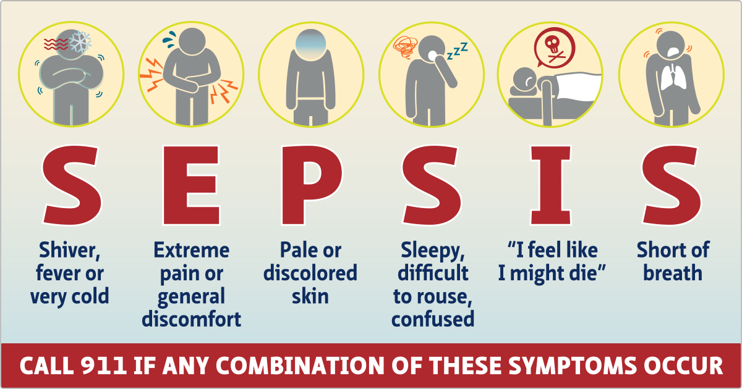
Special Considerations
• Prioritize early recognition, IV fluids and rapid hospital notification and transport.
• If signs of pulmonary edema, stop or limit fluid boluses.
• Hypotension is a late indicator for septic shock.

Slide 44


ICEMA # 14230
Maintain airway (advanced airway if needed)
Obtain vascular access
If hypotensive or s/s inadequate tissue perfusion administer IVF challenge:
Adult:
500 ml IV Fluid bolus, MR x1
If no response stop fluids and administer push dose epi
IV TKO for sustained SBP of 90mmHg
Peds:
20mL/kg IV fluid bolus, MR x1
If no response stop fluids and administer push dose epi
IV TKO for sustained SBP of 70 mmHg
If signs of pulmonary edema, stop or limit fluid boluses.

Slide 45
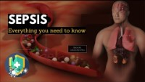
Video Review
Notes:
Sepsis: Everything You Need to Know-Medical Centric 3:58 seconds.
https://youtu.be/ZKX3HqE3eFg

Slide 46
References
Arizona Department of Health Services. Identification and Management of Sepsis on the Prehospital Environment. Retrieved from :https://www.azdhs.gov/documents/preparedness/emergency-medical-services-trauma-system/training/sepsis.pptx
Gabart, J.M. Pediatric Shock. Retreieved from: https://peds.arizona.edu/sites/default/files/curriculum-files/shock-presentation.ppt​
Haseer Koya H, Paul M. Shock. [Updated 2023 Jul 24]. In: StatPearls [Internet]. Treasure Island (FL): StatPearls Publishing; 2023 Jan-. Available from: https://www.ncbi.nlm.nih.gov/books/NBK531492/
Inland County Emergency Medical Agency, 2023. Retrieved from: https://www.sbcounty.gov/icema/main/policies_and_protocols.aspx
Lawanson-Nichols, M. & Kao, Y. The Severe Sepsis/Septic Shock Bundle: Why is it important? Retrieved from : https://www.uclahealth.org/sites/default/files/documents/Severe-Sepsis-Septic-Shock-Bundle-PowerPoint%20(1).pptx
National Association of Emergency Medical Technicians, 2020​. Retrieved from: https://www.naemt.org/
Society of Trauma Nurses (2023). Hemorrhagic Shock. Retrieved from: www.traumanurses.org​
Taha, M., & Elbaih, A. (2017) Pathophysiology and Management of Different Types of Shock. Narayana Medical Journal ​

Slide 47
References
The association between major complications of immobility during hospitalization and quality of life among bedridden patients: A 3 month prospective multi-center study - PMC (nih.gov)
Surgical Site Infections | Johns Hopkins Medicine
Sepsis - Symptoms & causes - Mayo Clinic
Sepsis (who.int)
Pictures of the World Wide Web 2024
Resource article Links:
https://www.ems1.com/ems-products/capnography/articles/sepsis-detection-and-monitoring-in-ems-ZNxOT3J6r2uOE778/
https://www.magonlinelibrary.com/doi/abs/10.12968/jpar.2022.14.10.425
https://www.ems1.com/ems-products/capnography/articles/how-capnography-can-be-used-to-identify-sepsis-e9XqviEHi9narckh/
https://www.ncbi.nlm.nih.gov/pmc/articles/PMC5942006/

Slide 48

Thank you
Thank you to the San Bernardino County EMS Educators Committee, ICEMA, and San Bernardino County EMS Officers for the making of this educational piece.

